Slide 1


Eliminating Domain Bias for
Federated Learning in
Representation Space
Jianqing Zhang¹
Yang Hua²
Jian Cao¹
Hao Wang³
Tao Song¹
Zhengui Xue¹
Ruhui Ma¹
Haibing Guan¹
1
2
3
Notes:
Hello everyone! I am happy to share our work Eliminating Domain Bias for Federated Learning in Representation Space.
This work is done by Shanghai Jiao Tong University, Queen's University Belfast, and Louisiana State University.

Slide 2


Federated Learning (FL)
In practice, clients generate their specific private data, as shown by the colorful icons here.
Local Data

Slide 3






Statistical Heterogeneity Issue
Client-specific private data brings the statistical heterogeneity issue
Local Model
Local Data
Global Model

Slide 4
Statistical Heterogeneity Issue
With heterogeneous data, clients’ local training turns the received global model to client-specific local models
Train
Before
Local
Training
After
Local
Training
Train

Slide 5
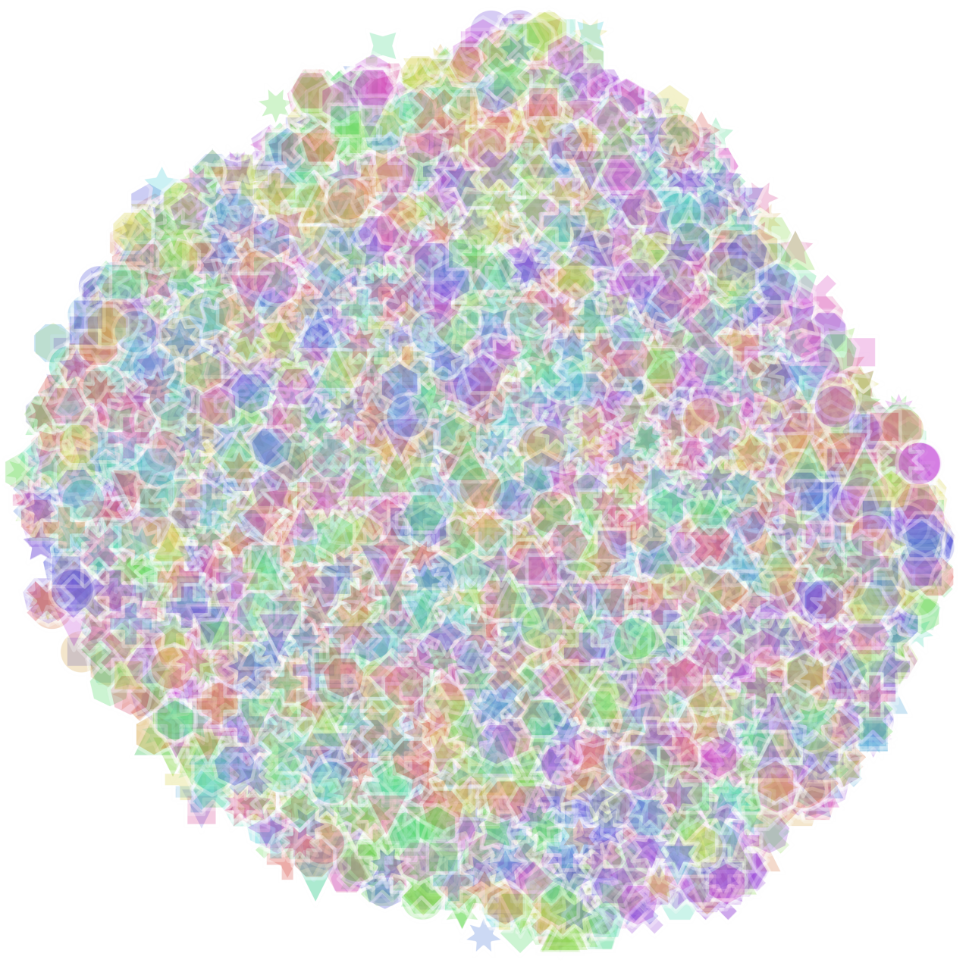
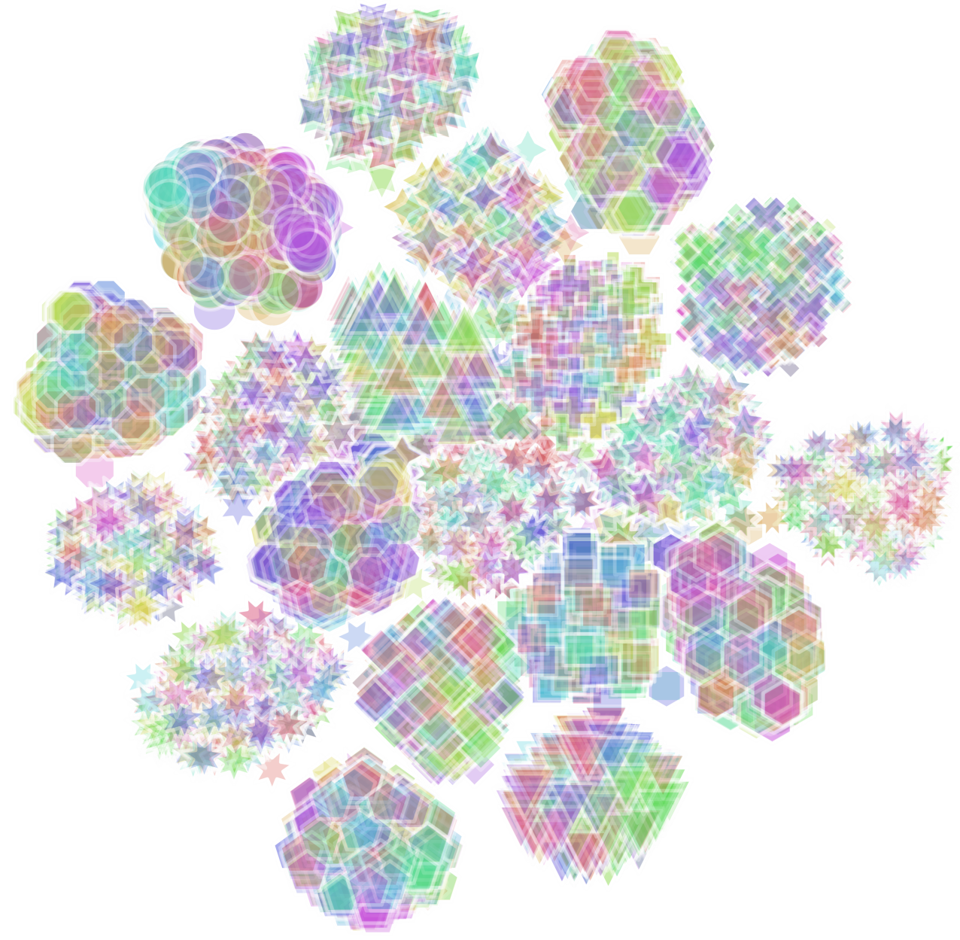
Representation bias phenomenon
Train
Before
After
After local training, the feature representations are biased to client-specific domains
(a) Before local training
(b) After local training
t-SNE visualization for representations before/after local training in FedAvg.
We use color and shape to distinguish labels and clients, respectively.
Representations form client-specific domains after local training.

Slide 6
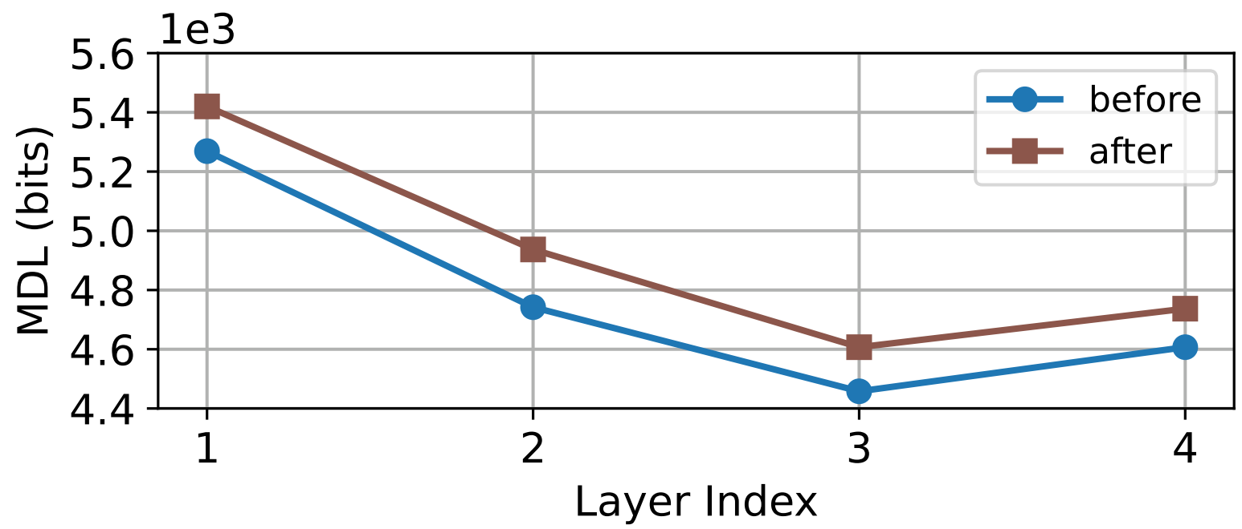
Representation degeneration phenomenon
Train
Before
After
At the same time, representations’ quality is also degenerated
Per-layer MDL (bits) for representations before/after local training in FedAvg.
A large MDL value means low representation quality.

Slide 7
Personalized FL (pFL)
pFL methods learn personalized modules, but

Slide 8



Personalized FL (pFL)
pFL methods learn personalized modules, but
feature extractors are still trained with only biased local data domains on clients, leading to
Feature Extractor
Biased
Feature Extractor
Not biased
Feature Extractor
Before local training

Slide 9
Personalized FL (pFL)
pFL methods learn personalized modules, but
feature extractors are still trained with only biased local data domains on clients, leading to
representation bias and representation degeneration during local training.
Feature Extractor
Feature Extractor
Biased
Feature Extractor
Not biased
Biased
Feature Extractor
Biased
Feature Extractor
Feature Extractor
Before local training
After local training

Slide 10
Our Domain Bias Eliminator (DBE)
Thus, we propose DBE to eliminate domain bias in representation space via two modules:
Notes:
To address these issues,

Slide 11
Our Domain Bias Eliminator (DBE)
Thus, we propose DBE to eliminate domain bias in representation space via two modules:
Personalized Representation Bias Memory (PRBM)
Mean Regularization (MR)

Slide 12
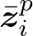
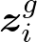

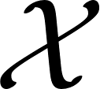
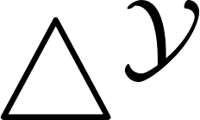

Personalized Representation Bias Memory (PRBM)
PRBM stores personalized (biased) representation information ( ) for each client, and
make the remaining information ( ) to be global.
Feature Extractor
Classifier
Local model (original)
Feature Extractor
$$⨁$$
Classifier
Local model (with PRBM)
Notes:
Now, let’s see the PRBM first,
The bottom figure shows this process

Slide 13
Personalized Representation Bias Memory (PRBM)
PRBM stores personalized (biased) representation information ( ) for each client, and
make the remaining information ( ) to be global.
second level representation
First level representation
Feature Extractor
$$⨁$$
Classifier
Local model (with PRBM)

Slide 14
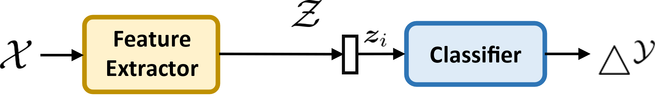
Personalized Representation Bias Memory (PRBM)
PRBM stores personalized (biased) representation information ( ) for each client, and
make the remaining information ( ) to be global.
Formally,
Local loss (original):
Notes:
Formally, this is the original loss, where we use the feature extractor f to produce z_i

Slide 15
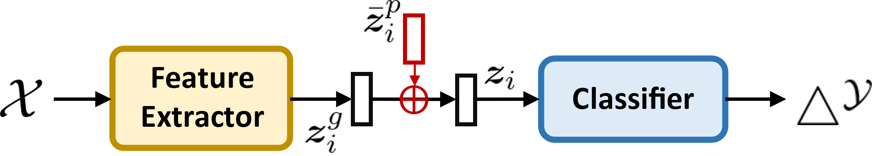
Personalized Representation Bias Memory (PRBM)
PRBM stores personalized (biased) representation information ( ) for each client, and
make the remaining information ( ) to be global.
Formally,
Local loss (original):
Local loss (with PRBM):
Notes:
But in the loss with PRBM, we use f to generate z_i^g, and combine z_i^g with z_i^p bar to form the original z_i

Slide 16
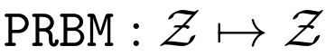
Personalized Representation Bias Memory (PRBM)
PRBM stores personalized (biased) representation information ( ) for each client, and
make the remaining information ( ) to be global.
Formally,
Local loss (original):
Local loss (with PRBM):
View the PRBM as a personalized translation transformation :
Notes:
We can also

Slide 17
Personalized Representation Bias Memory (PRBM)
PRBM stores personalized (biased) representation information ( ) for each client, and
make the remaining information ( ) to be global.
Formally,
Local loss (original):
Local loss (with PRBM):
View the PRBM as a personalized translation transformation :
Notes:
and rewrite the above loss to this formula

Slide 18
Personalized Representation Bias Memory (PRBM)
We make PRBM to be trainable to learn personalized representation information

Slide 19
Personalized Representation Bias Memory (PRBM)
We make PRBM to be trainable to learn personalized representation information
However, trainable PRBM requires guidance to recognize the global and personalized information
Personalized information?
Global information?
Feature Extractor
$$⨁$$
Classifier
Local model (with PRBM)

Slide 20

DBE: PRBM + Mean Regularization (MR)
MR explicitly guides the local feature extractor to generate with global information, by
further regularize to a globally shared client-invariant mean
Global information!
Feature Extractor
$$⨁$$
Classifier
Local model (with PRBM and MR)
Notes:
Thus, we devise

Slide 21
DBE: PRBM + Mean Regularization (MR)
MR explicitly guides the local feature extractor to generate with global information, by
further regularize to a globally shared client-invariant mean
A consensus obtained during the initialization period before FL
Global information!
Feature Extractor
$$⨁$$
Classifier
Local model (with PRBM and MR)

Slide 22
DBE: PRBM + Mean Regularization (MR)
MR explicitly guides the local feature extractor to generate with global information, by
further regularize to a globally shared client-invariant mean
Personalized information!
Global information!
Feature Extractor
$$⨁$$
Classifier
Local model (with PRBM and MR)
Notes:
Now the PRBM can learn to store the personalized representation information

Slide 23
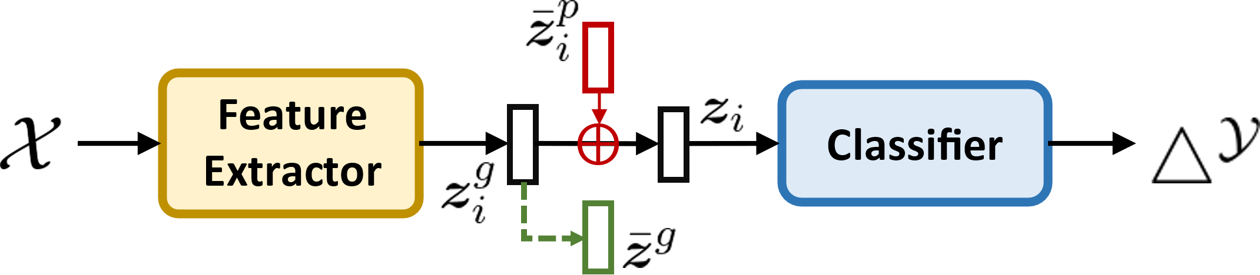
DBE: PRBM + Mean Regularization (MR)
MR explicitly guides the local feature extractor to generate with global information, by
further regularize to a globally shared client-invariant mean
Formally,
Local loss (with PRBM):
Notes:
Recall the

Slide 24
DBE: PRBM + Mean Regularization (MR)
MR explicitly guides the local feature extractor to generate with global information, by
further regularize to a globally shared client-invariant mean
Formally,
Local loss (with PRBM):
Local loss (with PRBM and MR):
Notes:
We now plus it with the MR term

Slide 25
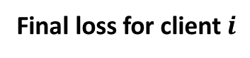
DBE: PRBM + Mean Regularization (MR)
MR explicitly guides the local feature extractor to generate with global information, by
further regularize to a globally shared client-invariant mean
Formally,
Local loss (with PRBM):
Local loss (with PRBM and MR):
Final loss for client $i$

Slide 26
Improved Bi-directional Knowledge Transfer
DBE can promote bi-directional knowledge transfer between server and client with
Theoretical guarantee

Slide 27
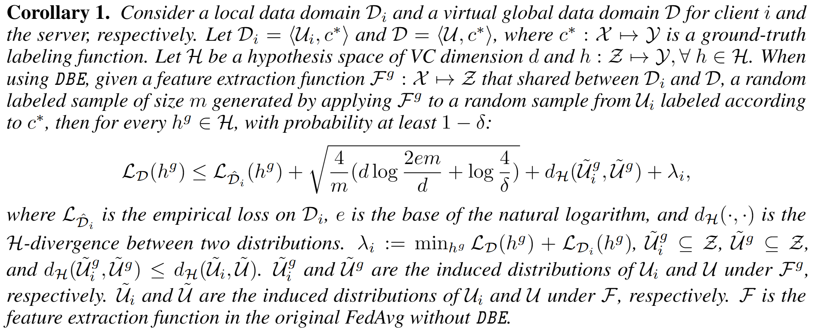
Improved Bi-directional Knowledge Transfer
Local-to-global knowledge transfer
Notes:
In Corollary 1, applying our DBE to FedAvg can achieve a lower divergence between the local and global domains in the first level of representation than FedAvg, thus learning a better feature extractor.

Slide 28
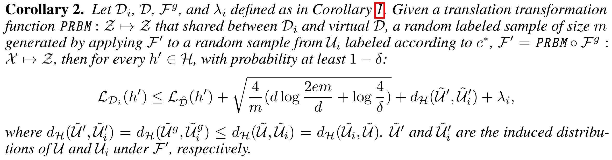
Improved Bi-directional Knowledge Transfer
Global-to-local knowledge transfer
Please refer to our paper for proofs.
Notes:
In Corollary 2, applying our DBE to FedAvg can also achieve a lower divergence between the local and global domains in the second level of representation than FedAvg, thus facilitating local tasks.

Slide 29
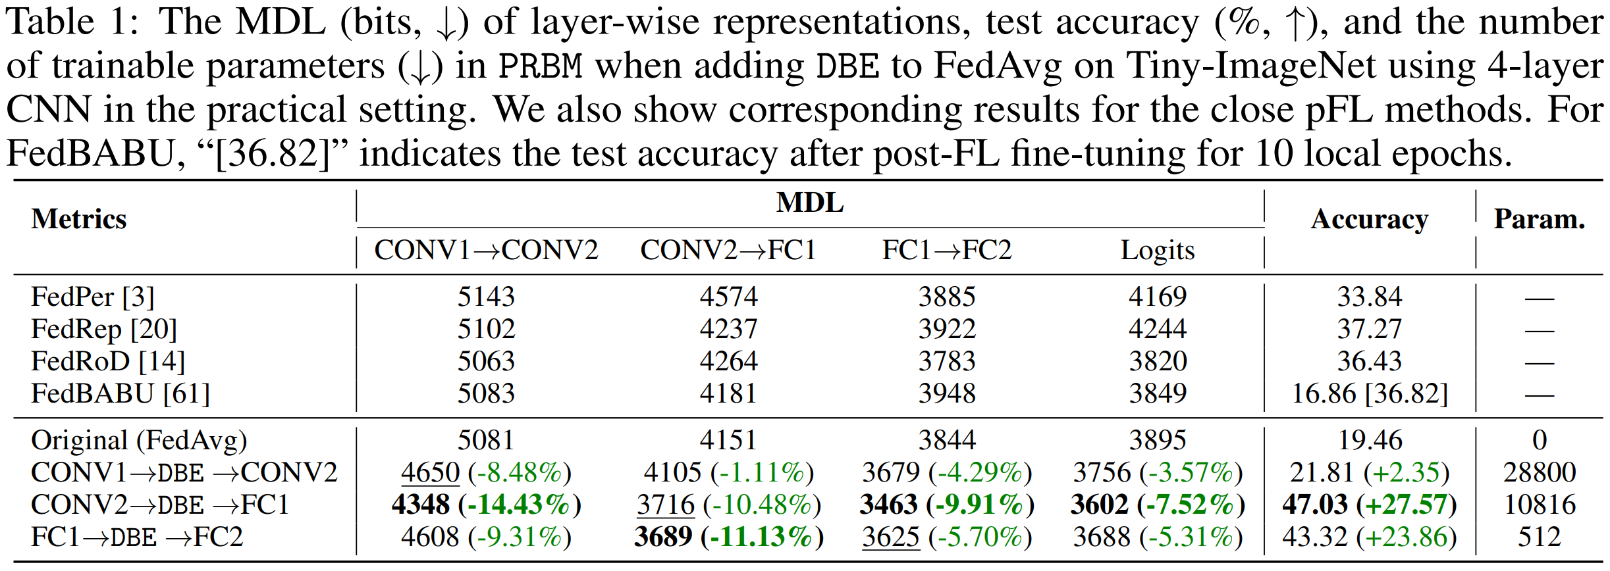
Extensive Experiments
How to Split the Model?
Notes:
Our DBE is effective when inserting it before any layer

Slide 30
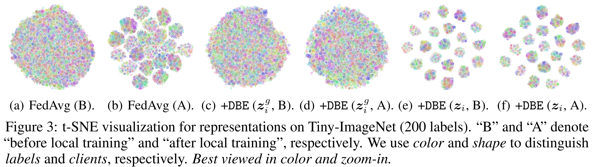
Extensive Experiments
Eliminate Representation Bias for the First Level of Representation after local training
Notes:
And our DBE can also

Slide 31
Extensive Experiments
DBE can greatly improve existing FL methods in both generalization and personalization abilities

Slide 32
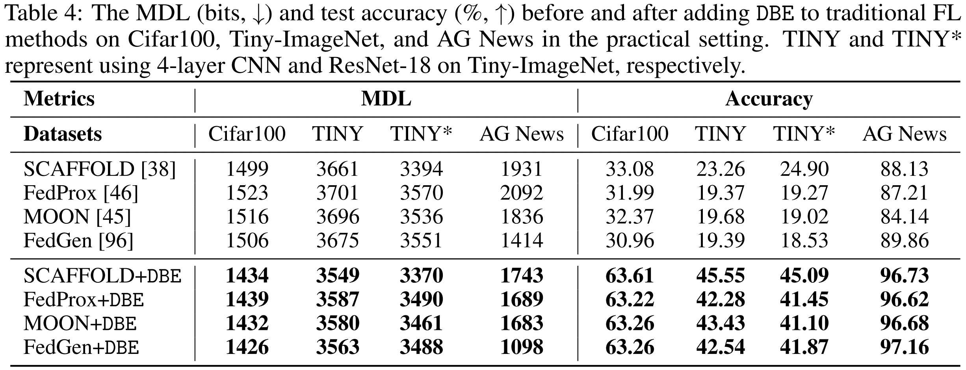
Extensive Experiments
DBE promotes traditional FL methods in both MDL and accuracy by at most
-22.35% in MDL (bits) and
+32.30 in accuracy (%)
Notes:
It can

Slide 33
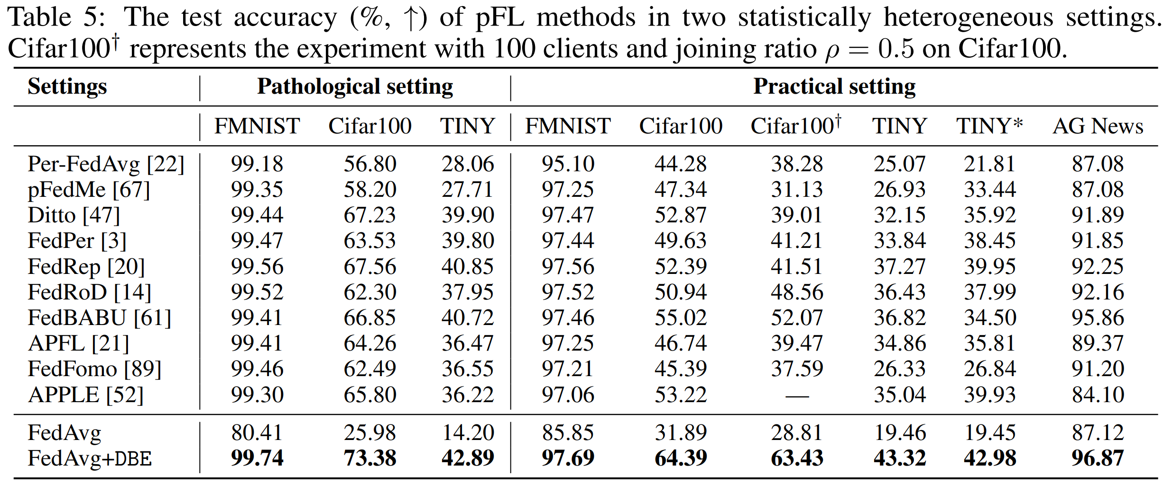
Extensive Experiments
DBE greatly improves FedAvg at most +47.40 on Cifar100 in the pathological setting and
outperforms the SOTA pFL methods by up to +11.36 on Cifar100†
Notes:
It can

Slide 34
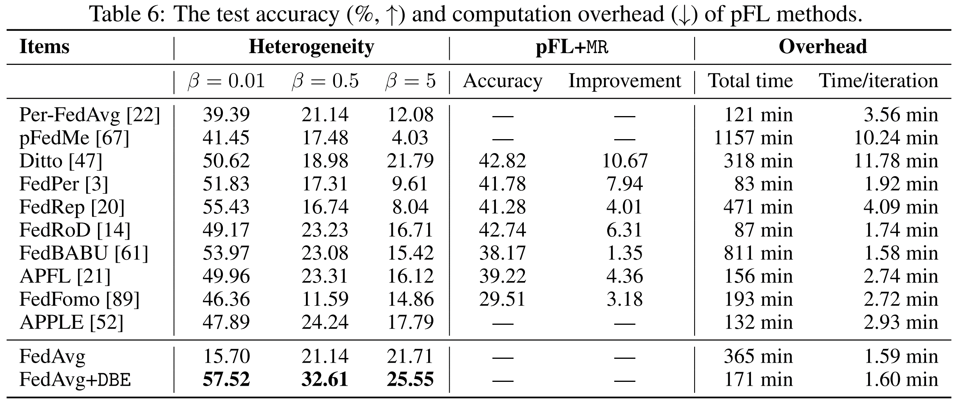
Extensive Experiments
Other experiments also show the effectiveness and efficiency of our DBE.

Slide 35

Eliminating Domain Bias for
Federated Learning in
Representation Space
Paper with code: https://github.com/TsingZ0/DBE
E-mail: tsingz@sjtu.edu.cn
Paper with code
Thanks!
Notes:
Here is the link of our paper and code.
Please feel free to contact us.
Thanks!

